Slide 1





Low-Fidelity Design and Justification Presentation

Slide 2

Introduction
Our app is designed to set up and manage your device, enabling you to monitor your plants by analyzing sensor readings.
A few user needs from past milestones:
User friendliness
Plant care tips and recommendations
Bluetooth support
Unlimited plant profiles
Notes:
From milestone two and three we found a few key points to focus on:
User friendliness
Plant care tips and recommendations
Bluetooth support
Unlimited plant profiles

Slide 3
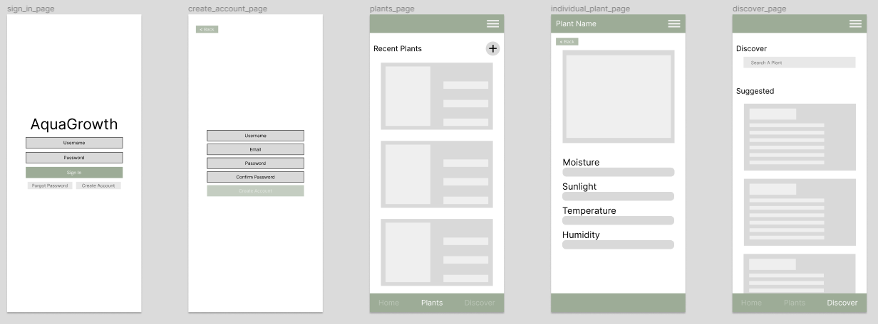
Design 1

Slide 4
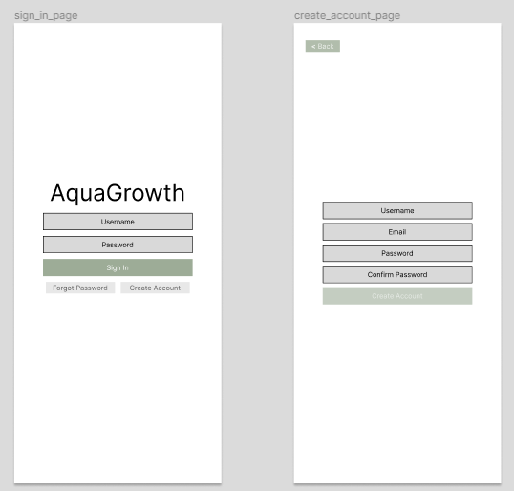
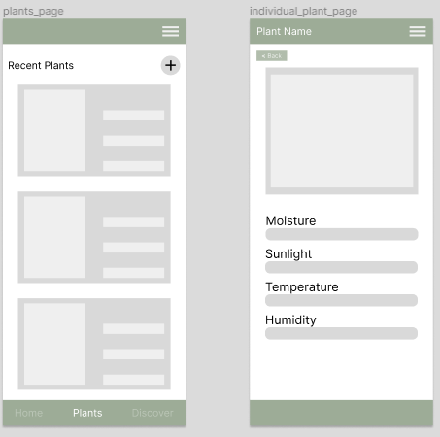
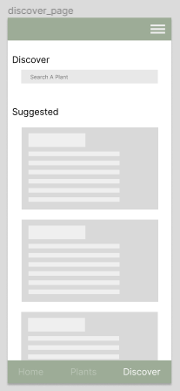
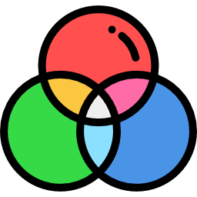
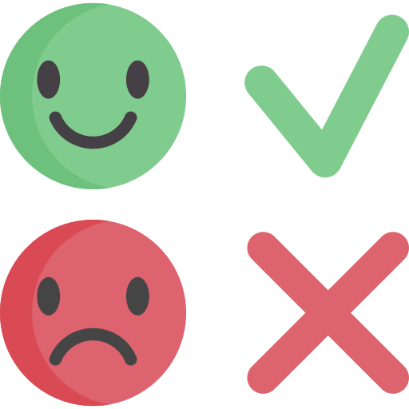
Strengths and Weakness of Design 1
Color scheme
Simple sign-in layout (username and password) including verification for account creation.
Personalized focus on specific plants, offers comprehensive information on sensors
Enables searching for specific plants to gather insights on proper care
Green color choice represents plants and eco-friendly environment
Risk of information overload, interface may be confusing
Balancing act needed for usefulness and functionality; should not be overly complex
The chosen green color appears dull and may be perceived as boring
lacks other sign-in options like Google, Meta, or Apple.
Notes:
Sign in and Create Account Page
Pros - Simple layout to sign in directly from username and password. Includes an email verification process in the create account page.
Cons - May pose a challenge to certain individuals without emails, such as signing up with only usernames or phone numbers. Does not have the option for signing with google, meta, or apple.
Plants page
Pros - Allows users to focus on personalization for specific plants that they care for. Additionally, the plant pages provide comprehensive information about Moisture, Sunlight, Temperature and Humidity sensors.
Cons - Although the options provide information, it can provide information overload leading users to be confused with the interface. Additionally, the individual plant page may need more specific information such as graphs.
Discover Page
Pros - The discovery page lets you search for a specific plant to gain insight on ways to care for your plant properly.
Cons - This page is a balancing act between usefulness and functionality, it needs to not be overly complex.
Overall color scheme
Pros - The chosen color, green represents plants and an eco friendly environment.
Cons - Although the color is green, the color is dull and boring.

Slide 5
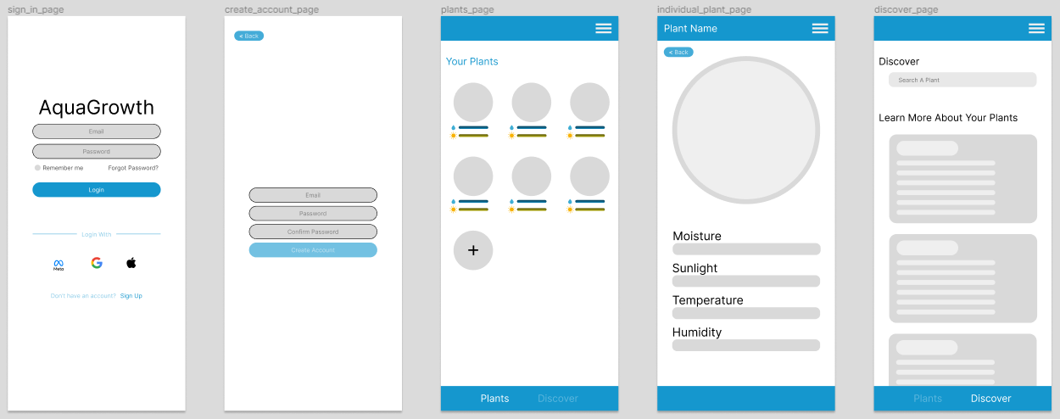
Design 2

Slide 6
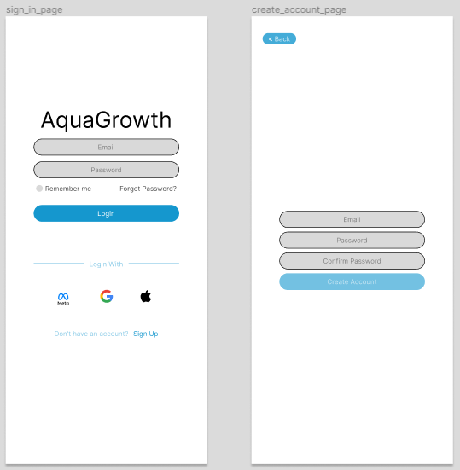
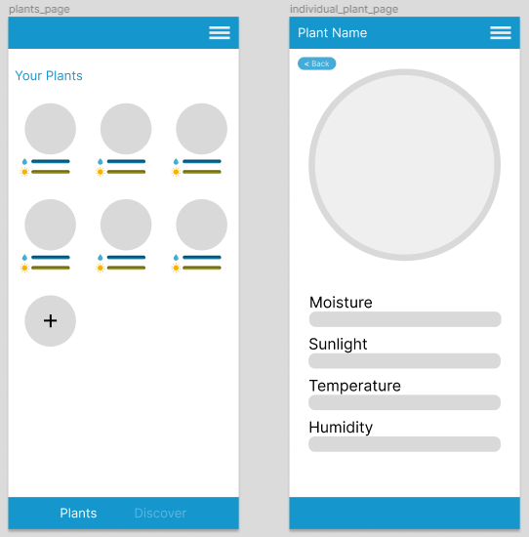
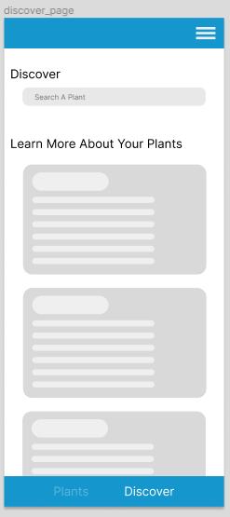
Strengths and Weakness of Design 2
Color scheme
Offers multiple sign in options. (Meta, Google, Apple)
Kept personalization but adopts a circular layout rather than a rectangular one.
Kept original discover page but adopted a circular format as well.
The chosen blue color scheme symbolizes sustainability and simplicity.
The logo is currently plain text. Doesn’t have anything visual.
Has empty space and buttons can move to hamburger menu.
May provide information overload in the design
it may be more associated with water than plants.

Slide 7
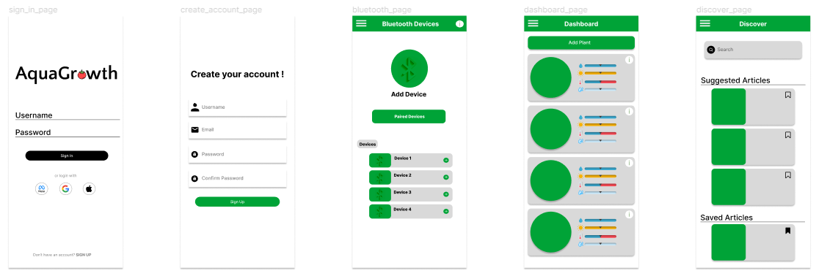
Design 3

Slide 8
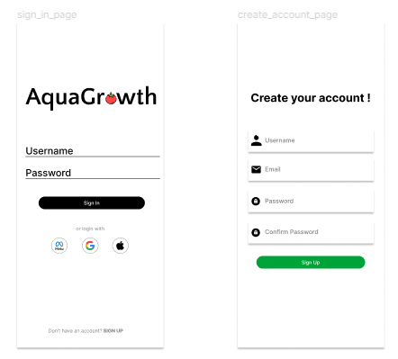
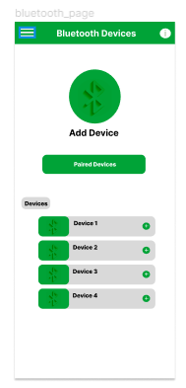
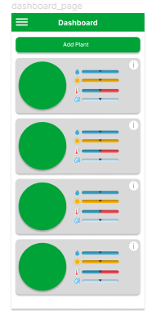
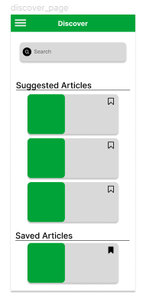
Strengths and Weakness of Design 3
Offers multiple sign in options and adds the Aqua Growth logo.
Visual indicator for connected devices. Features a scan for device.
Combines plant page with a circular and rectangular format. Condensed with the “i” indicator.
Keeps the original discover features but adds a bookmark feature.
Lacks the round edges and bubble format.
Potential security concerns based on the accessibility of the Bluetooth device
Only provides a general overview for your plant.
Possible clutter issue as bookmarks are directly under the search bar and article page

Slide 9
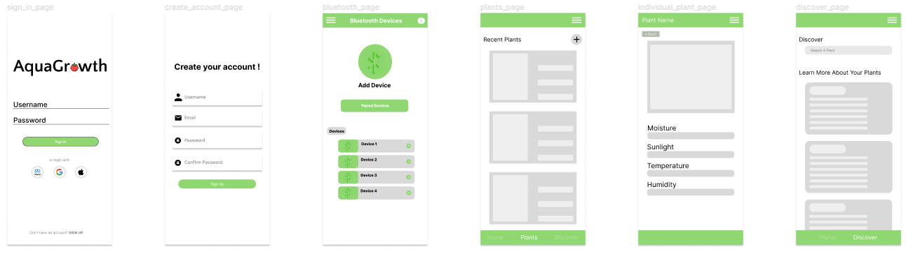
Final Design Selection
The final design selection is a combination of our past three designs. We selected all the notable features and combined it into one final design selection.

Slide 10



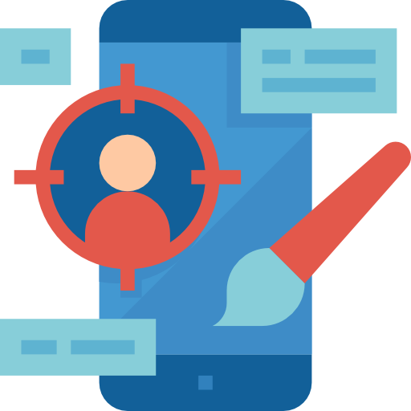
Conclusion
Components Included
User Needs Considerations
User Friendliness Emphasis
Competitive Edge
Sign-in Page
Create Account Page
Bluetooth Page
Plants Page
Discover Page
Identified desire for Bluetooth connectivity and unlimited plant profiles.
Prioritized unlimited plant profiles for reusability aspect.
User feedback highlighted the importance of ease of use in day-to-day workflows.
Created a separate plant page to address usability concerns regarding inactive plants on the dashboard.
Goal to stand out through support for multiple sensors (moisture, sunlight, temperature, humidity).
Opted for Bluetooth as an alternative due to the device's low energy and low-distance nature.

Slide 11

Questions and Answers
Questions and Answers Session

